Slide 1
Media training
March 25, 2013

Slide 2
Lesson 1
Don’t mistrust the media.

Slide 3
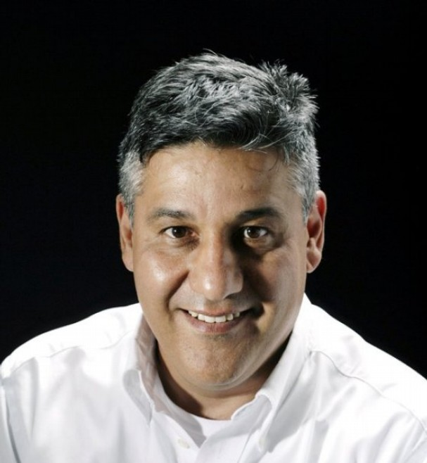
Lesson 1: Don’t mistrust the media
This man
is no more out to get you than …

Slide 4
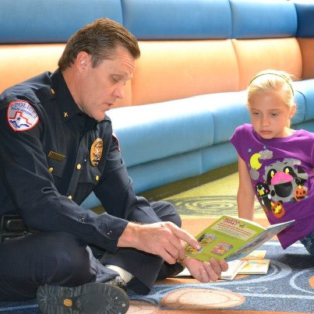
Lesson 1: Don’t mistrust the media
This man:
Or …

Slide 5
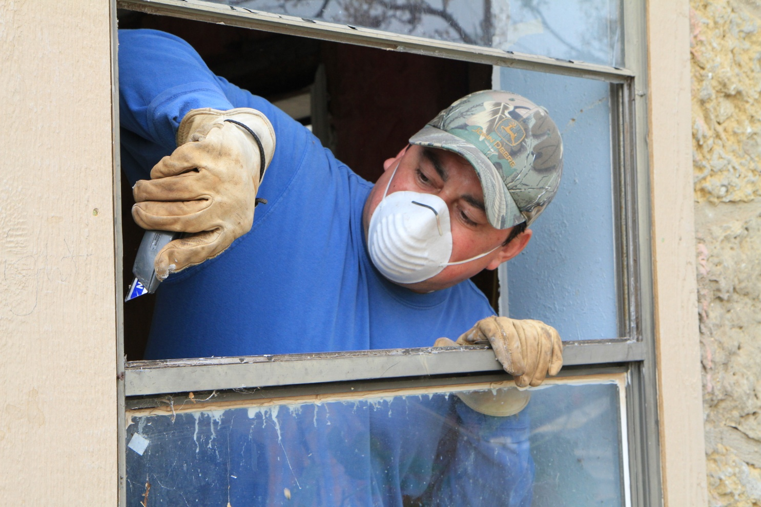
Lesson 1: Don’t mistrust the media
This man
Or …

Slide 6
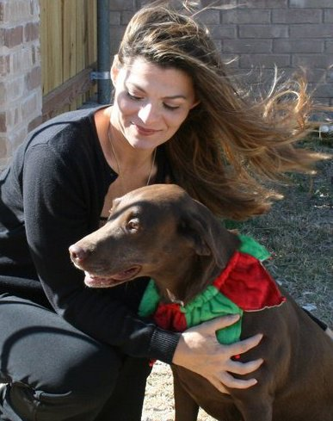
Lesson 1: Don’t mistrust the media
This woman

Slide 7
Lesson 1: Don’t mistrust the media
Reporters, police officers, code compliance officers and building inspectors all have jobs to do. It’s not personal.

Slide 8

Lesson 1: Don’t mistrust the media
Be nice.
Adversarial relationships with the media are unwinnable wars.

Slide 9
Lesson 1: Don’t mistrust the media
Be understanding. Reporters are human; they make mistakes. Just like …

Slide 10
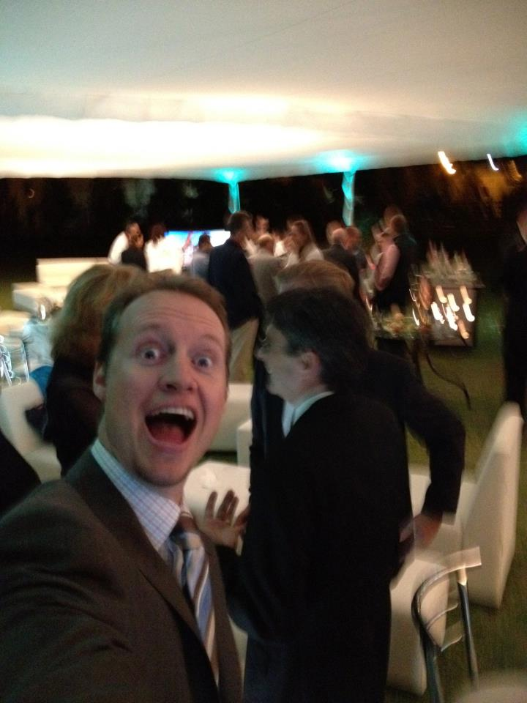
Lesson 1: Don’t mistrust the media
This man
Or, to be fair …

Slide 11
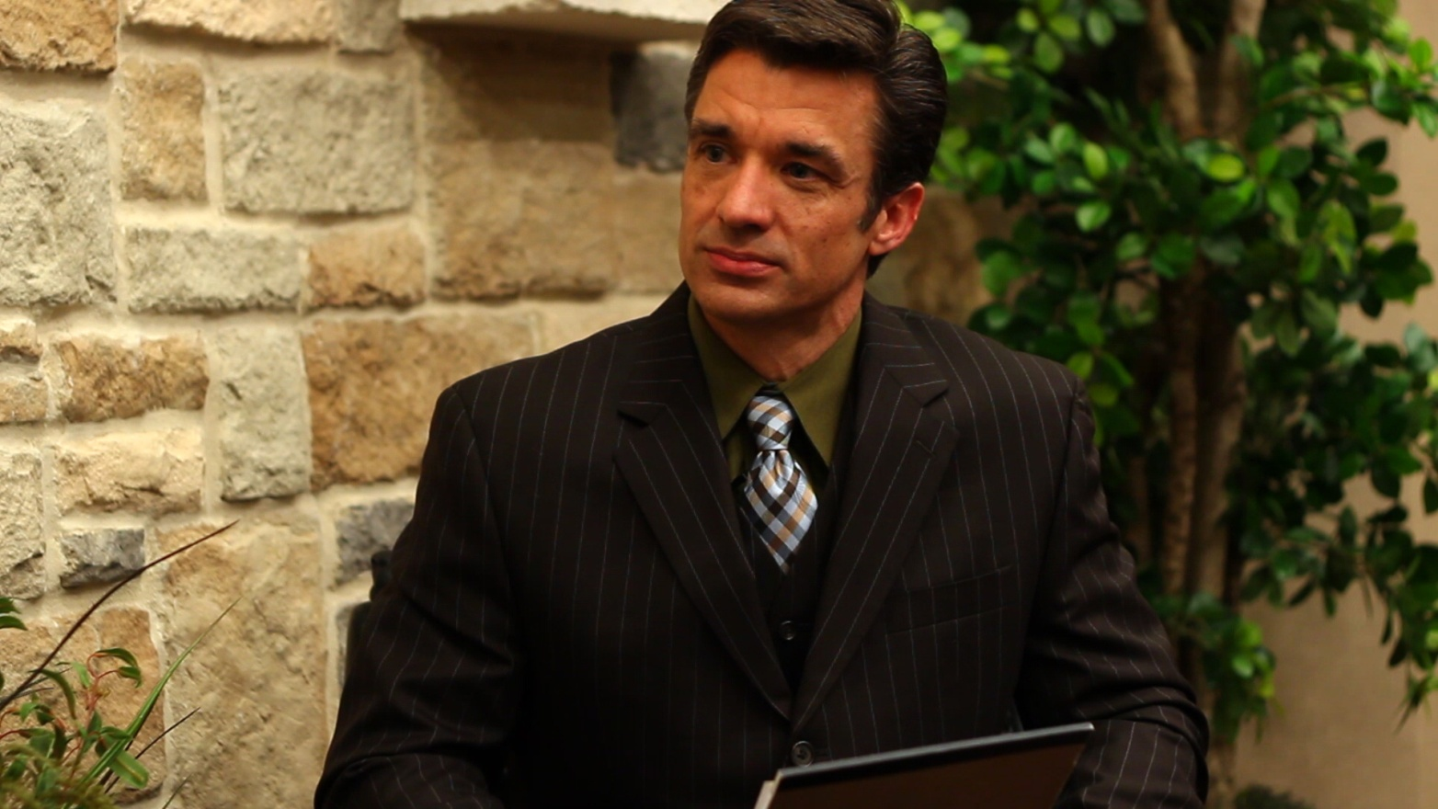
Lesson 1: Don’t mistrust the media
This man

Slide 12
Lesson 1: Don’t mistrust the media
So cut them some slack … though do ALWAYS tell the PIO when an error is reported and a correction is needed.

Slide 13
Lesson 1: Don’t mistrust the media
Remember: They help us AT LEAST as much as we help them. (And in actuality, they help us FAR MORE.)

Slide 14
Lesson 2
Answering the tough question

Slide 15
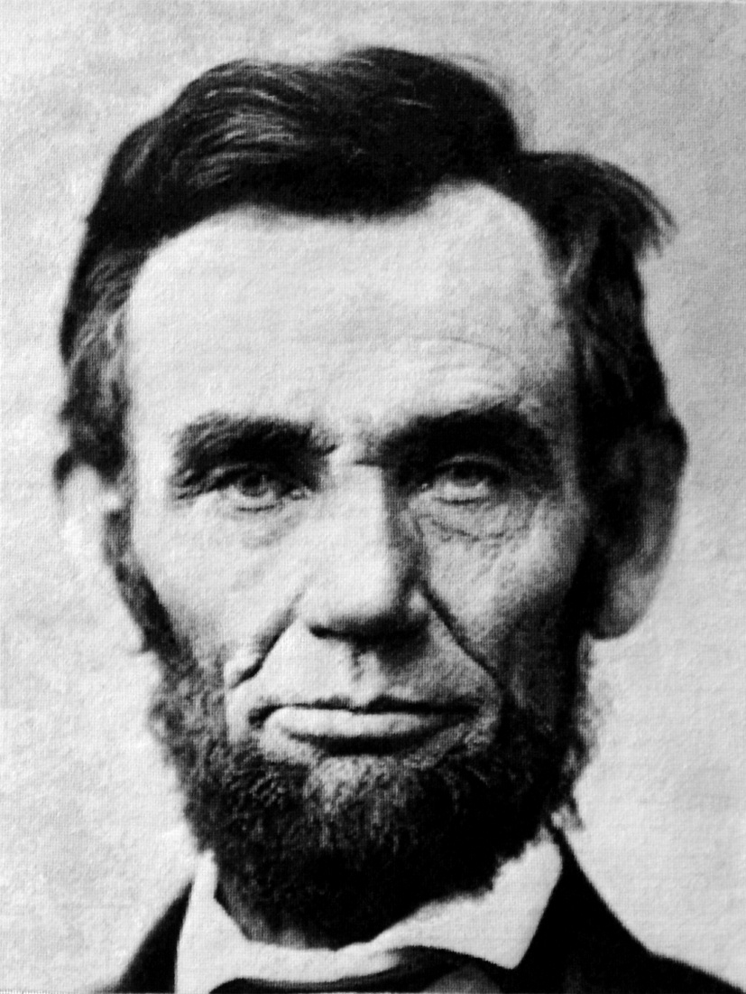
Lesson 2: Answering the tough question
Answer honestly.

Slide 16

Lesson 2: Answering the tough question
No “No comment.”

Slide 17
Lesson 2: Answering the tough question
It is, however, all right not to know …
And to say so …
Only without saying, “I don’t know.”
Alternatives:
“Let me get back to you on that.”
“I’d like to double-check my facts before answering that.”
“That’s a good question. Let me look into that.”

Slide 18
Lesson 2: Answering the tough question
Be dispassionate. You’ll be less likely to saying something you (and your boss … and the organization) regret.
Don’t be glib about serious subjects. Serious subjects demand sobriety.
Email interviews: They are time-consuming, but can help avoid confusion.

Slide 19
Lesson 3
Don’t assume … and talk plainly.

Slide 20
Lesson 3: Don’t assume … and talk plainly
Reporters don’t share your expertise and institutional knowledge. Don’t assume they have a base level of understanding about the story they’ve been assigned.
Don’t use acronyms, jargon and technical language: The COSADC recommends that a Section 108 loan be leveraged against CDBG funds backed by a CO so the TIRZ can invest in an ion exchange plant that will be located in a PDD or a CG zone that is adjacent to the MPO facility, which houses an SAPD officer assigned to Sector 3 by CID. (Have you filled out a PAF?)

Slide 21
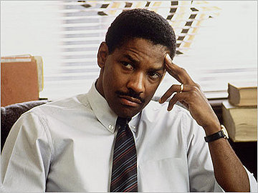
Lesson 3: Don’t assume … and talk plainly
Be like Denzel in “Philadelphia”
“Now explain it to me like I’m a 4-year-old.”

Slide 22
Lesson 3: Don’t assume … and talk plainly
Ask: “Does that make sense?” Then pay attention to non-verbal cues.
Slow down when talking to newspaper reporters.
Using these tips should help minimize errors and misquotes.

Slide 23
Lesson 4
Put your best face forward.

Slide 24
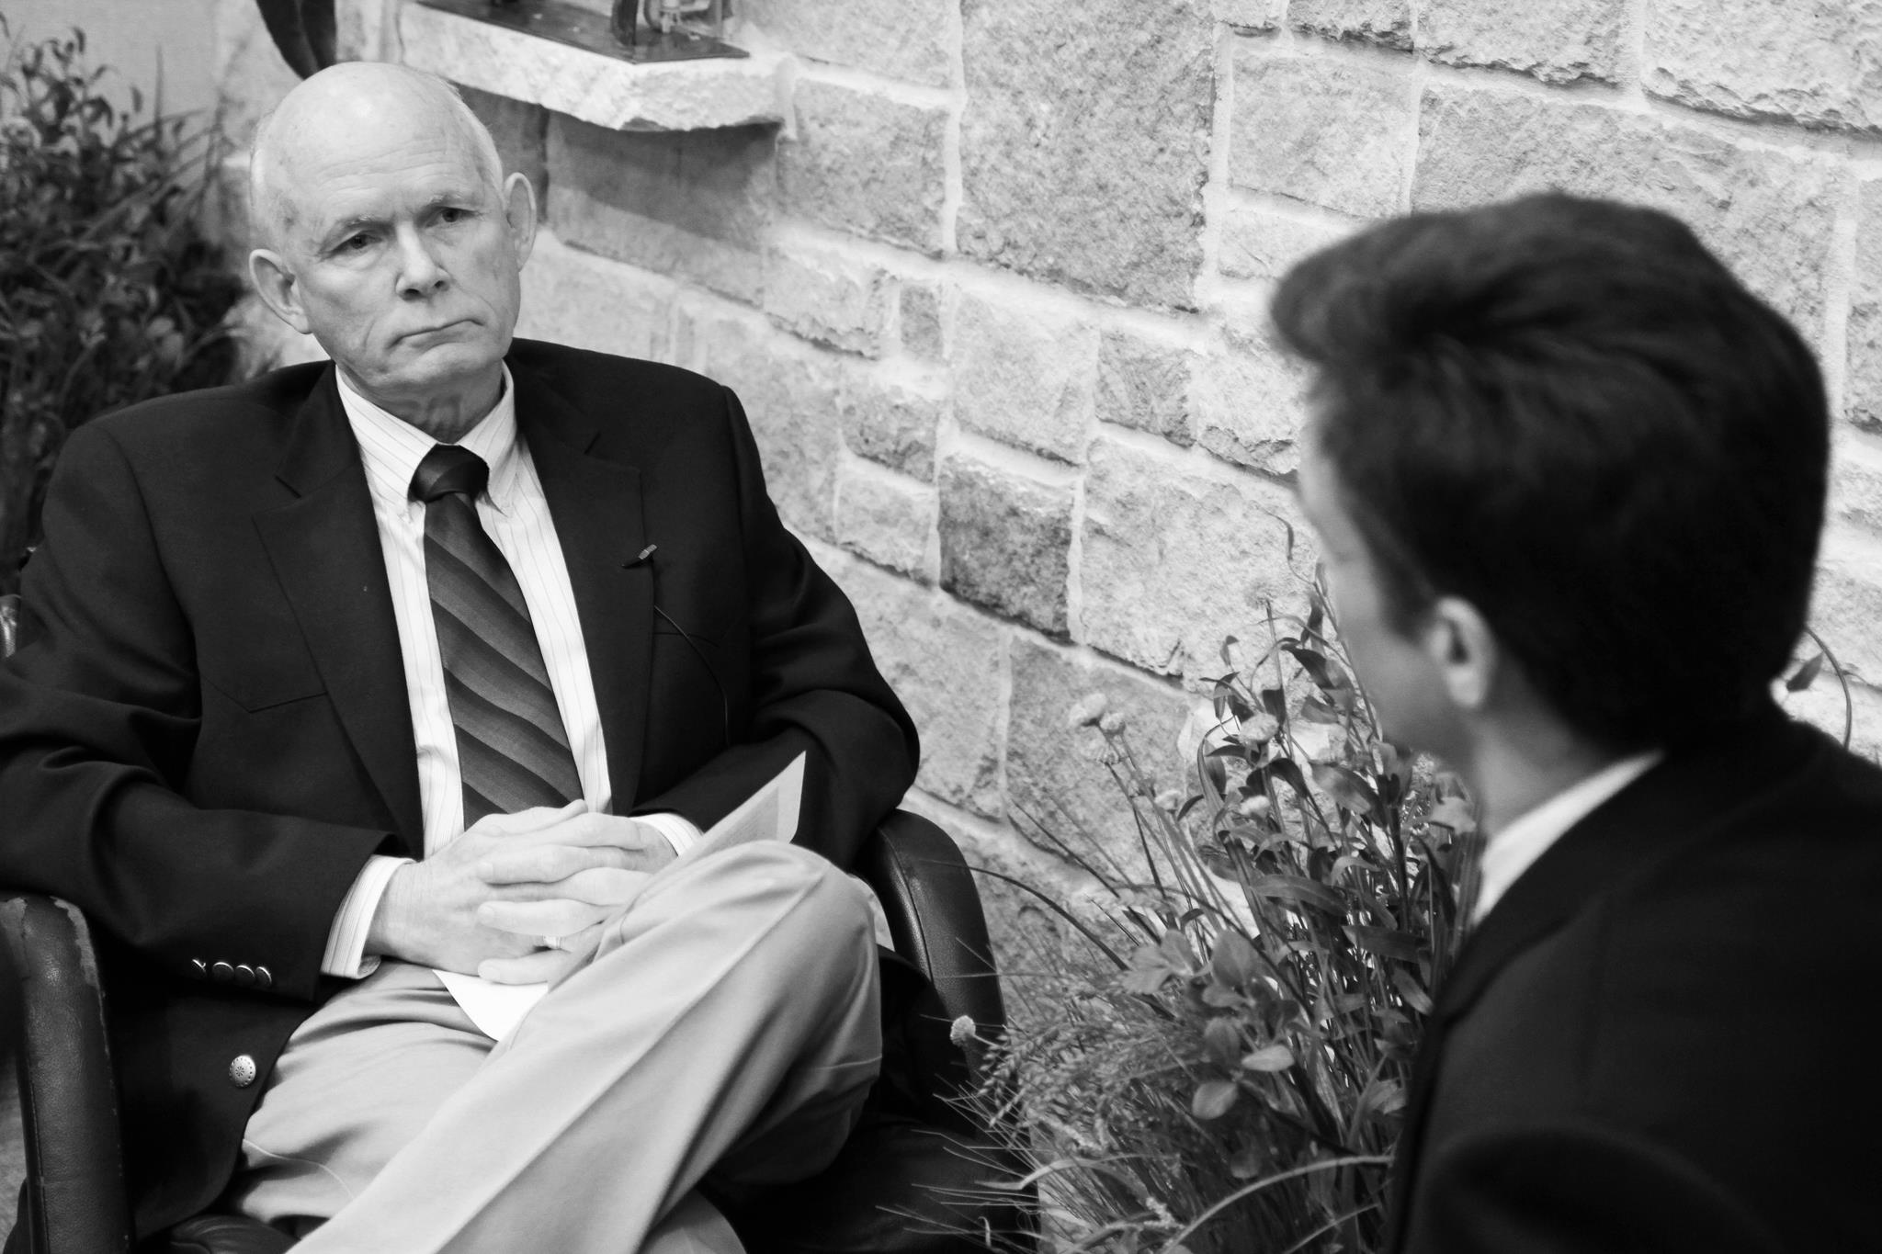
Lesson 4: Put your best face forward
Appearances matter on TV. Look professional.

Slide 25
Lesson 4: Put your best face forward
Remember whom you’re representing. At that moment, you’re not …

Slide 26
Lesson 4: Put your best face forward
You’re …

Slide 27

Lesson 4: Put your best face forward

Slide 28
Lesson 4: Put your best face forward
An interview is an opportunity to inspire public confidence in us.

Slide 29
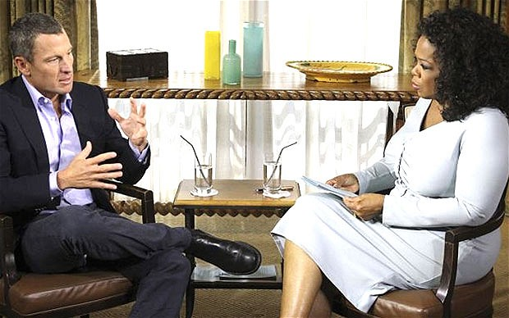
Lesson 4: Put your best face forward
There’s no need to be nervous.
An interview is just a conversation … likely over something you’re knowledgeable & passionate about.

Slide 30
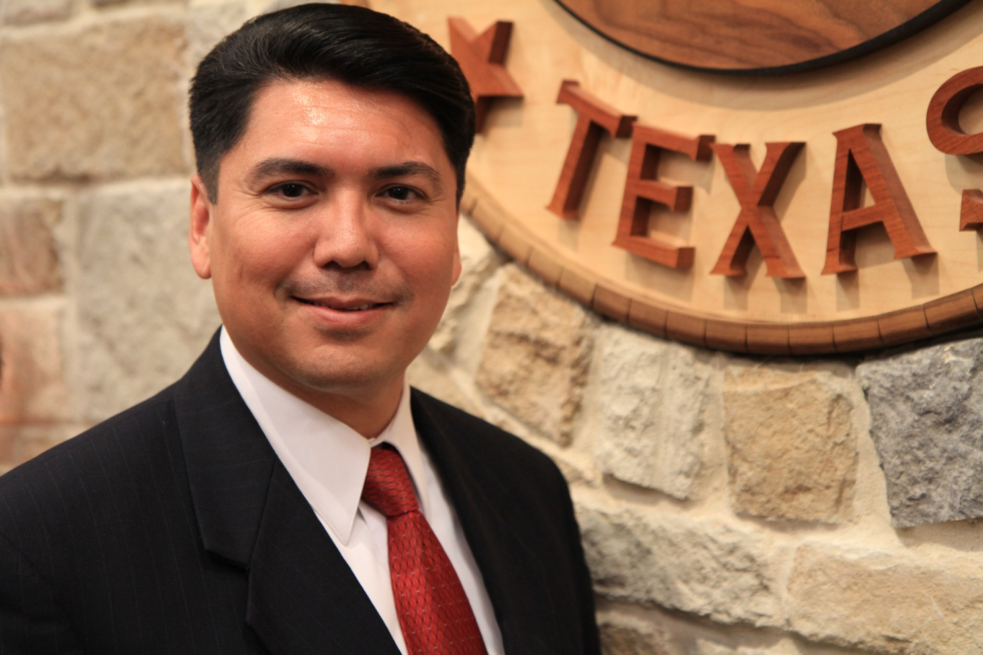
Lesson 4: Put your best face forward
Look at the interviewer, not the camera.
Smile when appropriate.

Slide 31
Lesson 5
Use your Public Information Office.

Slide 32
Lesson 5: Use your Public Information Office
We can help you shape your message so it is focused and polished. To excel at an interview, you must know what you want to communicate and accomplish.
We can help craft a media plan for getting your message out to the widest audience.
We WON’T ask someone to do an interview if we’re not confident they’ll represent the City well.
We’re happy to sit in on interviews.
We’re here to make you and the City look good.

Slide 33
Questions?
(We’d love suggested topics for the next training.)
All of these materials will be posted on the intranet.

