Slide 1
Water Advisory Board
March 29, 2016

Slide 2
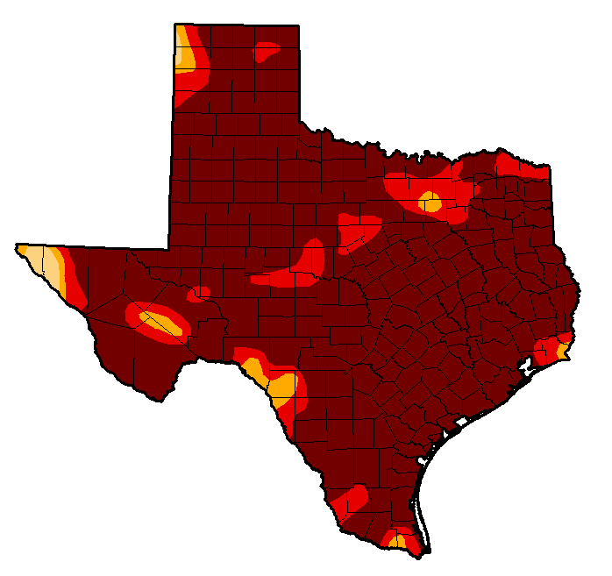
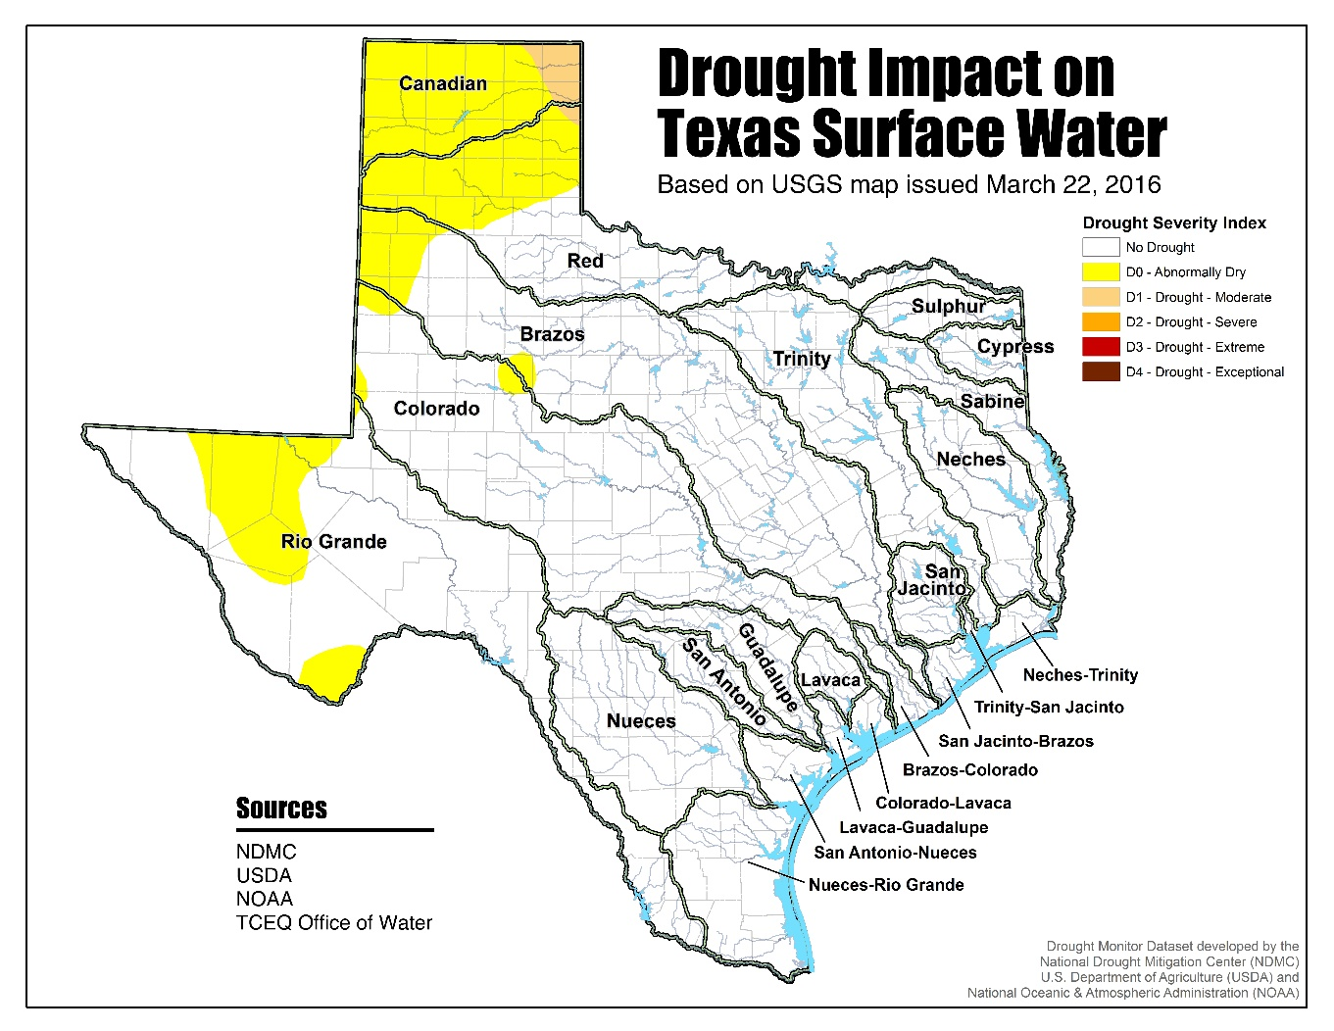
Is the Drought Over?
Sept. 27, 2011
March 22, 2016

Slide 3
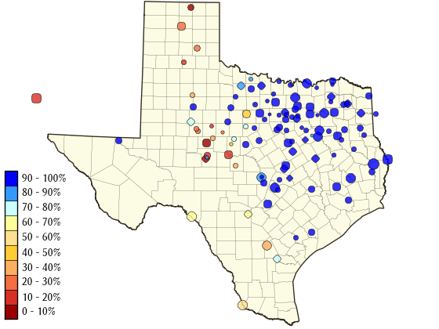
Is the drought over?
Water supply reservoirs: 86.9% full as of 3/28/16

Slide 4
Current supplies
9 Months
O.H. Ivie & Hickory
March 2016 – December 2016
11 Months
O.C. Fisher & Hickory
January 2017 – November 2017
6 Months
Twin Buttes, Lake Nasworthy & Hickory
December 2017 – May 2018
26 Months

Slide 5
Conservation Plan – Proposed Revisions
“Water Efficiency Action Group” suggestions
Comparison to similar cities
Proposed adjustments to the plan
Broaden trigger points
Implementation of drought stages
Outside watering intervals

Slide 6
Recommendation
Approval and support for enacting Drought Level I for resolution to be taken to April 5, 2016, City Council meeting

Slide 7
Water Advisory Board
March 29, 2016

